Slide 1
Lecture 14
Extreme Adaptive Optics
Claire Max
AY 289
February 26, 2020
Based in part on slides from
Bruce Macintosh and Sandrine Thomas

Slide 2
Outline
Science parameter space for Exoplanet systems
Direct imaging of exoplanets with ground-based AO
Approaches to high-contrast imaging with current telescopes: Angular Differential Imaging
Coronagraphs to block light from host star
Gemini Planet Imager: one example of the current state of the art
Recent scientific results: directly imaged planets and disks

Slide 3
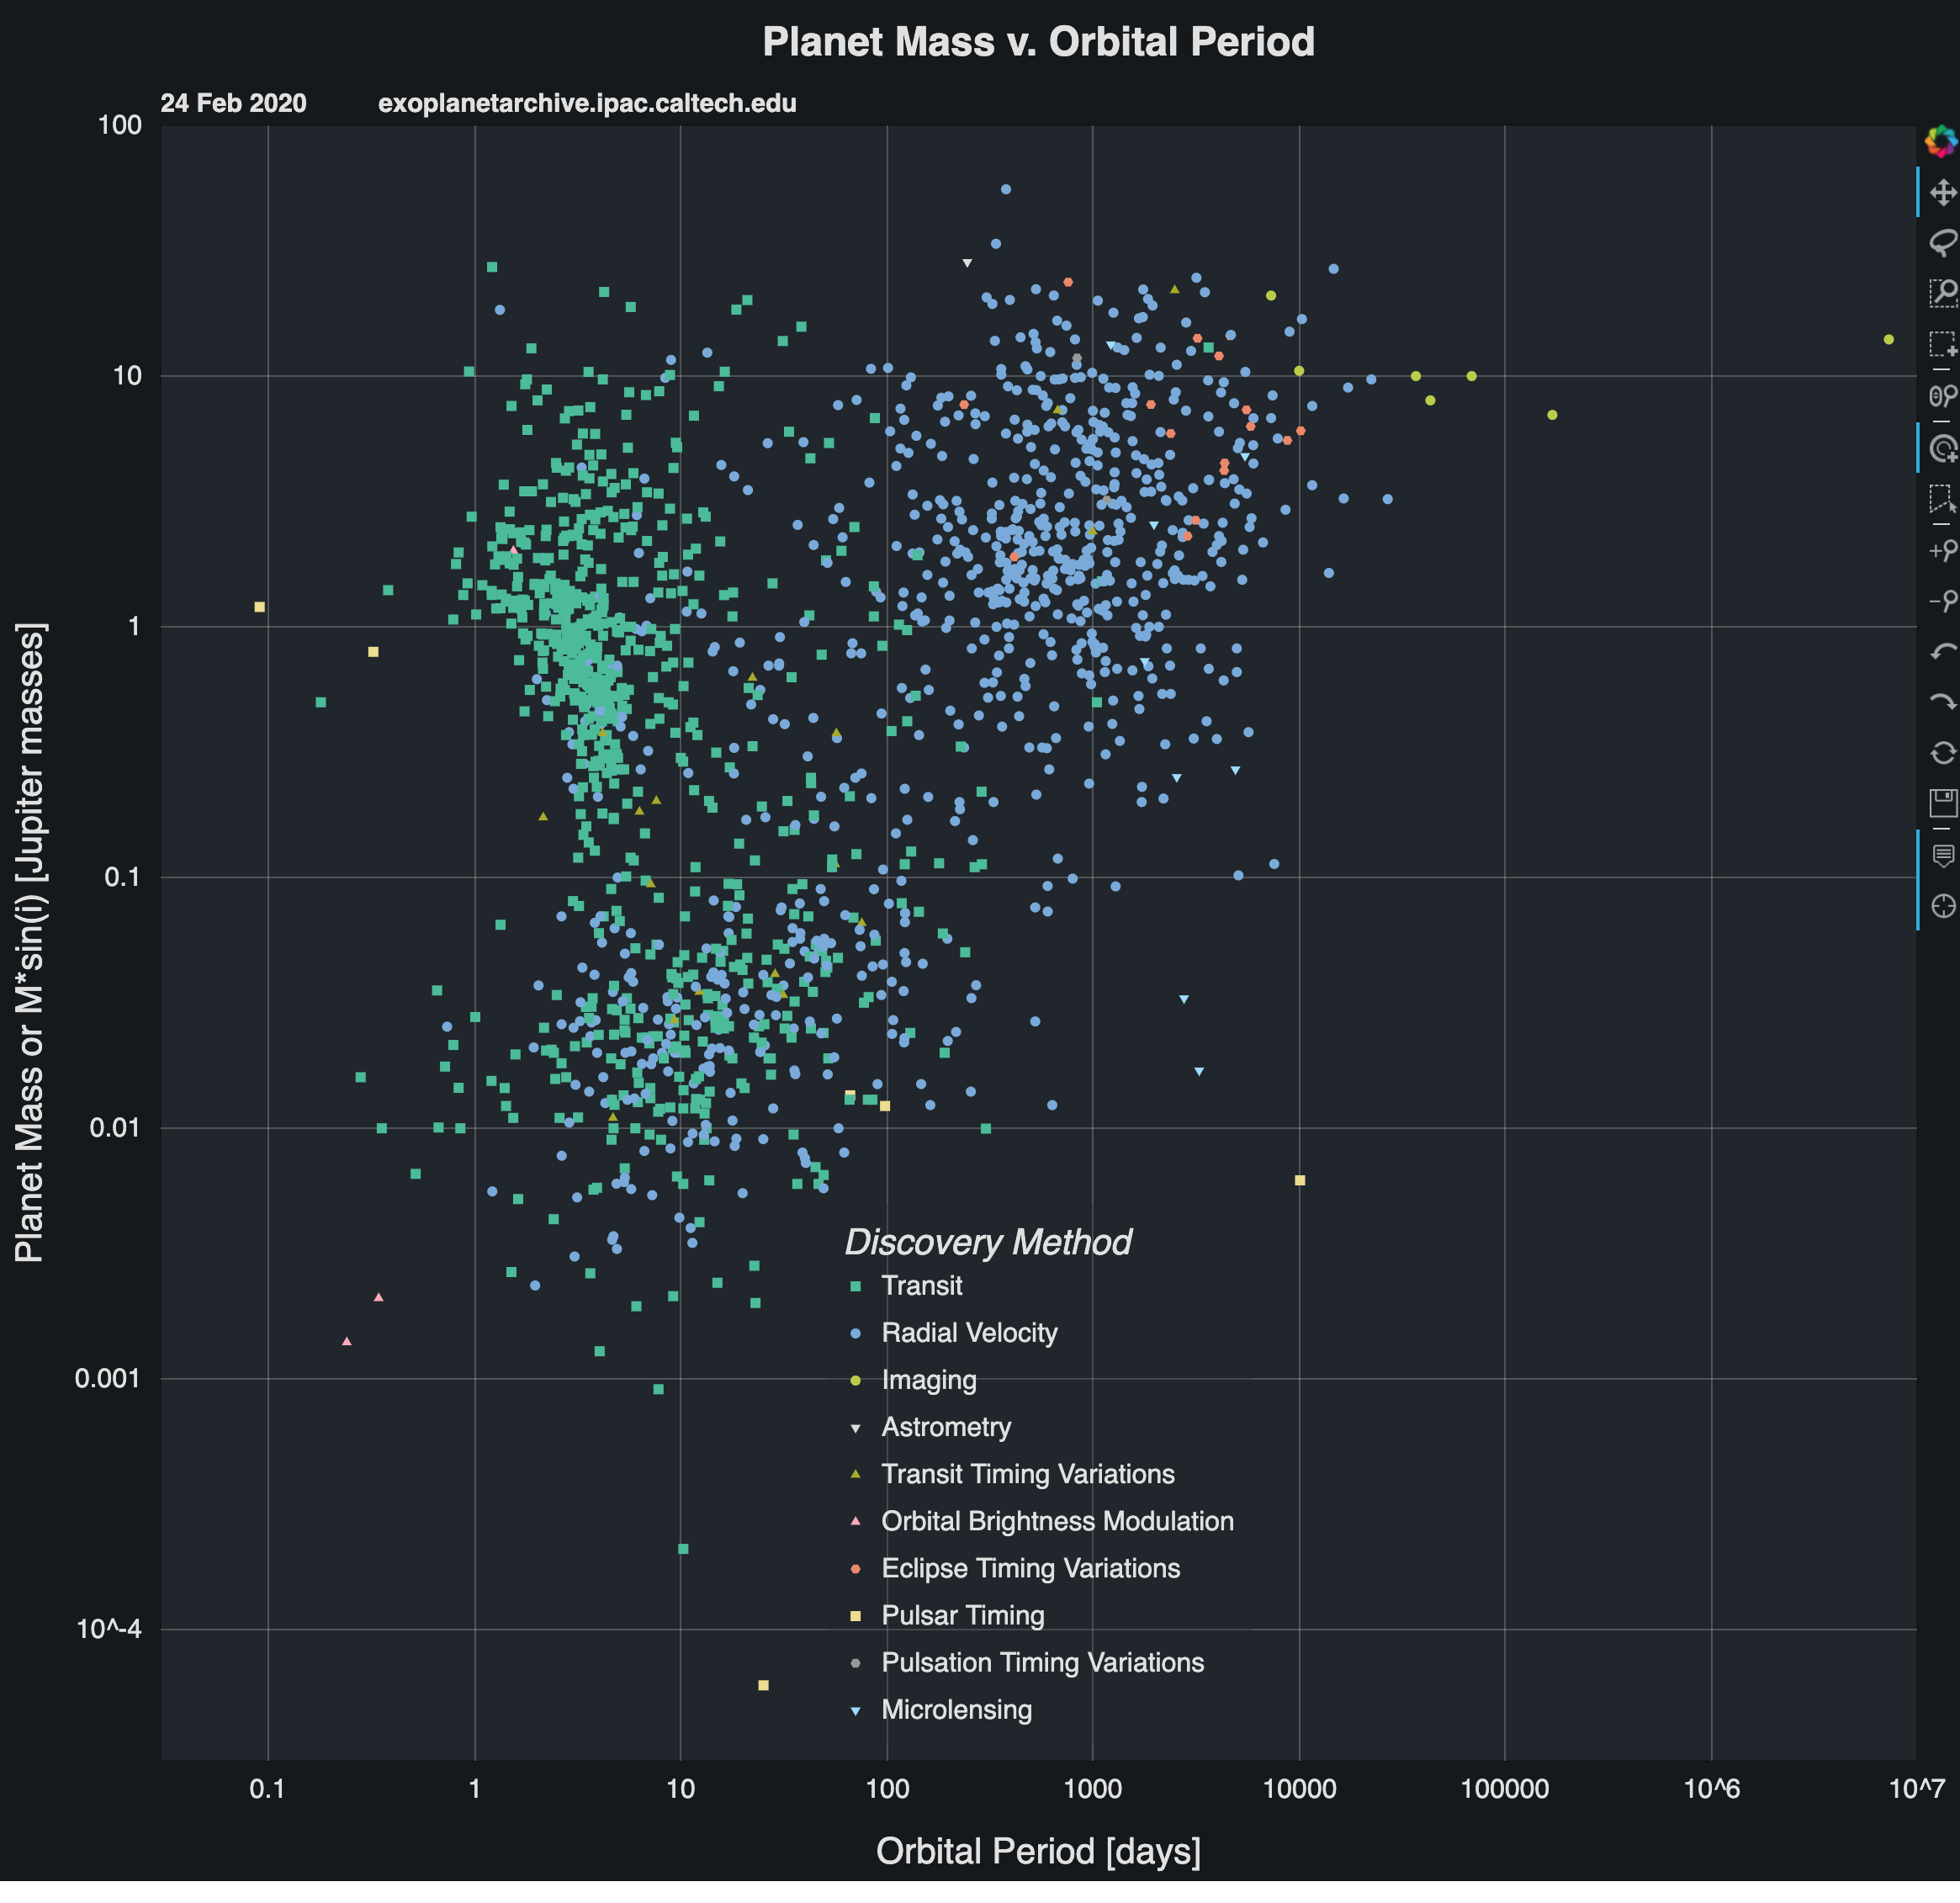
Exoplanets as of 2020
Today 30-40 directly imaged exoplanets

Slide 4
Working requirements for direct imaging
Contrast between flux from host star and planet
  Depends on wavelength, type of planet, type of star, distance of planet from star, etc.
Order of magnitude for sun-like star
  Earth: visible 10⁻⁹ to 10⁻¹⁰
  mid-IR 10⁻⁷
  Required contrast ratios for gas giants and for M dwarf host starts are not so stringent (10⁻⁶ ?)
Inner Working Angle typically a few 𝜆 / D

Slide 5
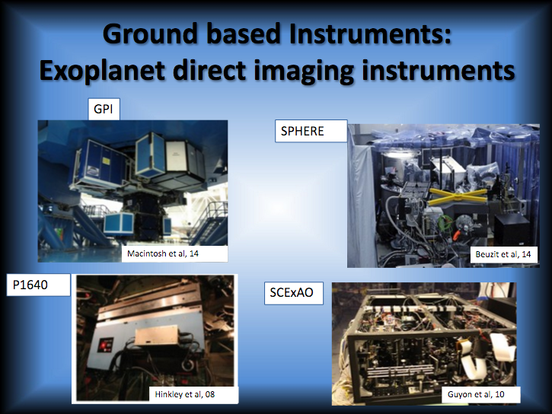

Slide 6
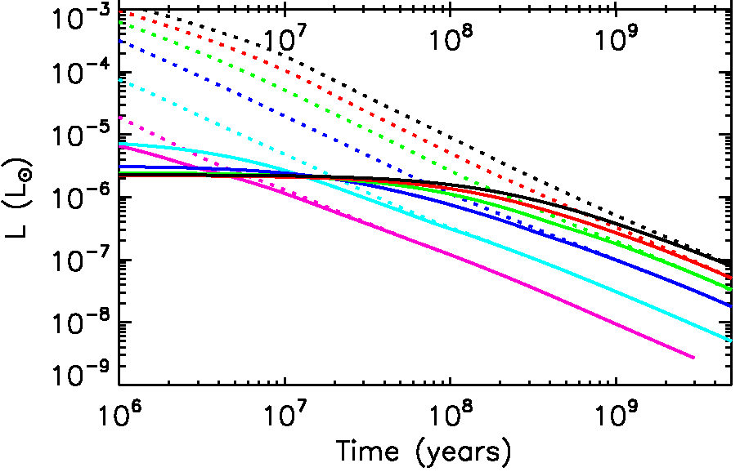
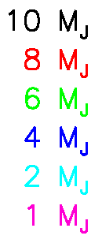
Brightness of ExAO targets: Gas Giants
Hot start
Normal AO regime
HR8799
ExAO regime
Low-entropy core accretion models
Marley et al 2007

Slide 7
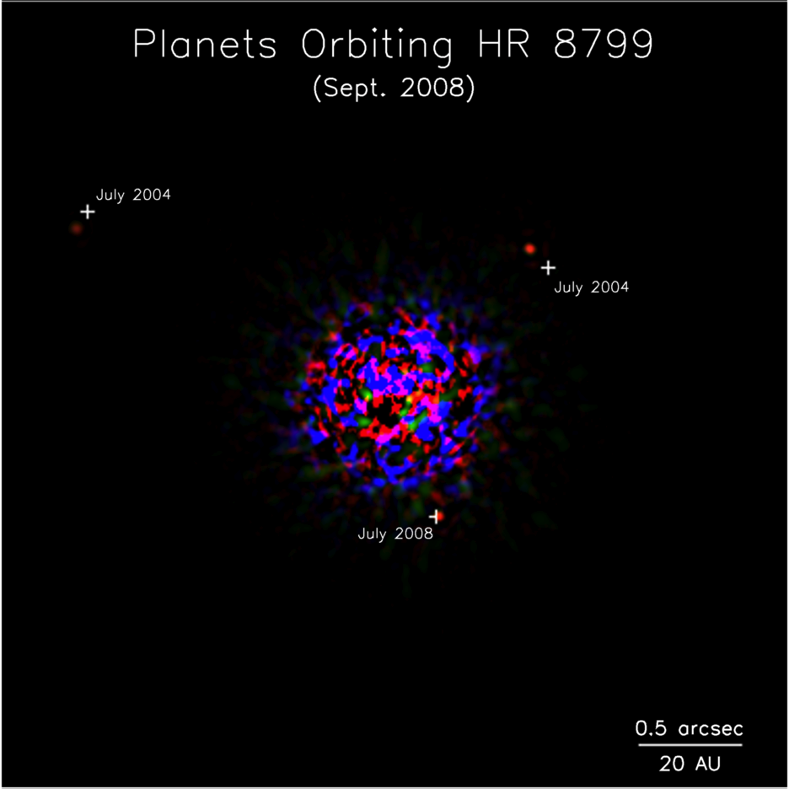
First images of an extrasolar planetary system (Keck and Gemini AO)
Marois et al. 2008 Science Mag

Slide 8
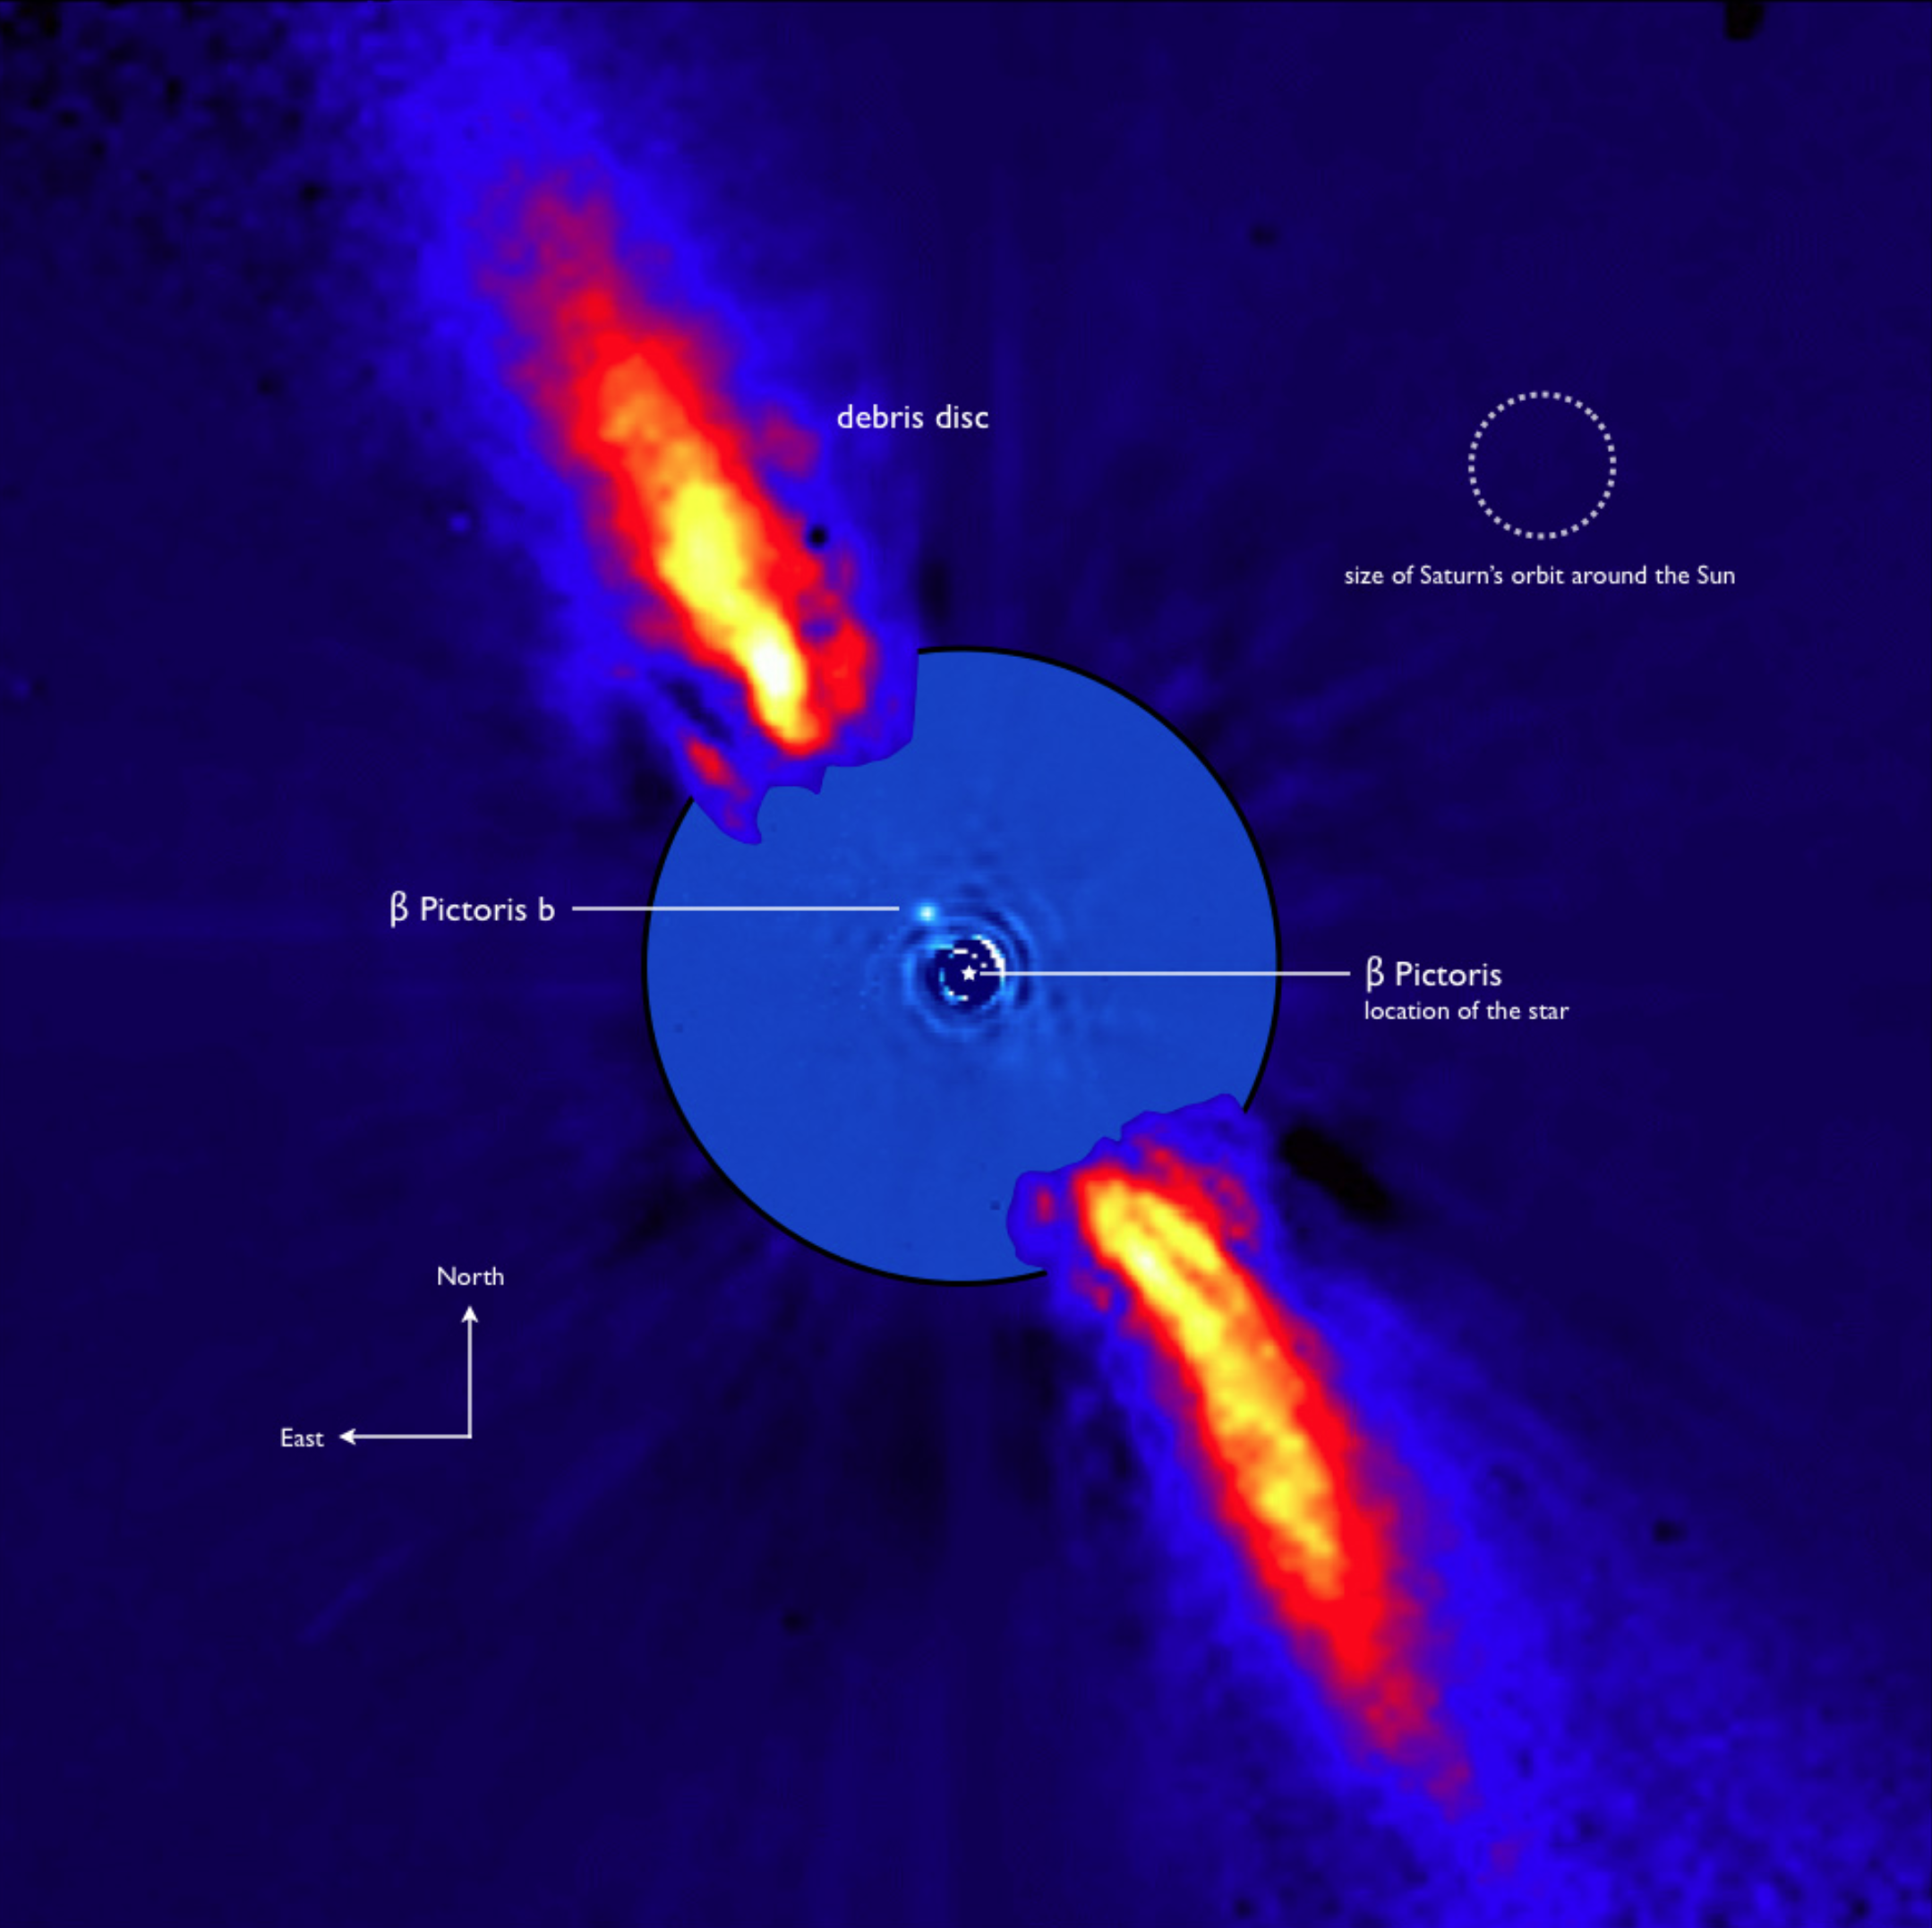
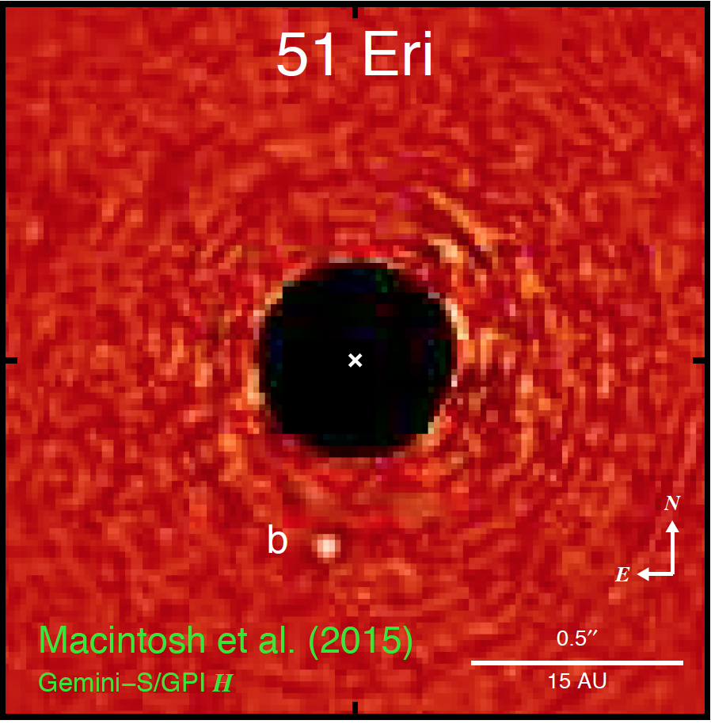
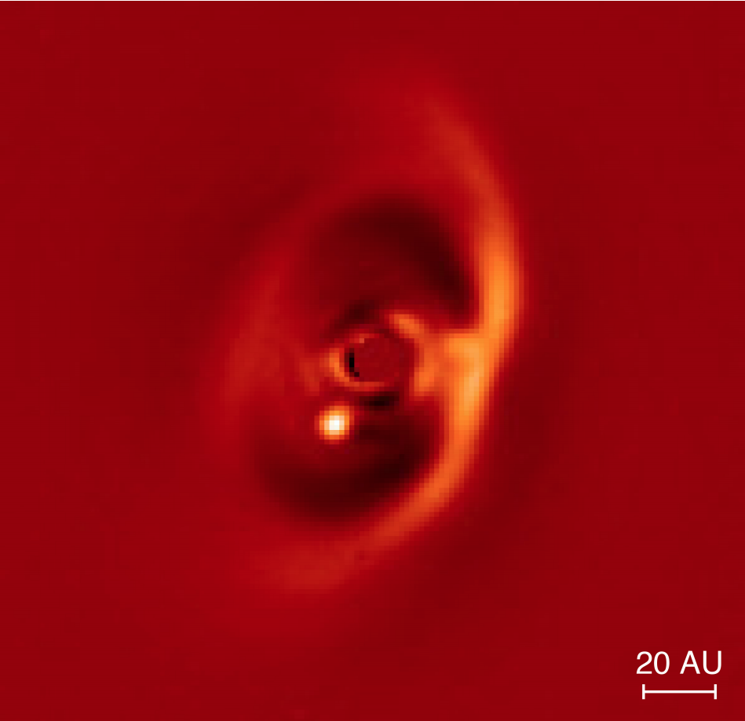
More directly imaged exoplanets
Beta Pic b
VLT NACO
51 Eri b
GPI
PDS 70
SPHERE

Slide 9
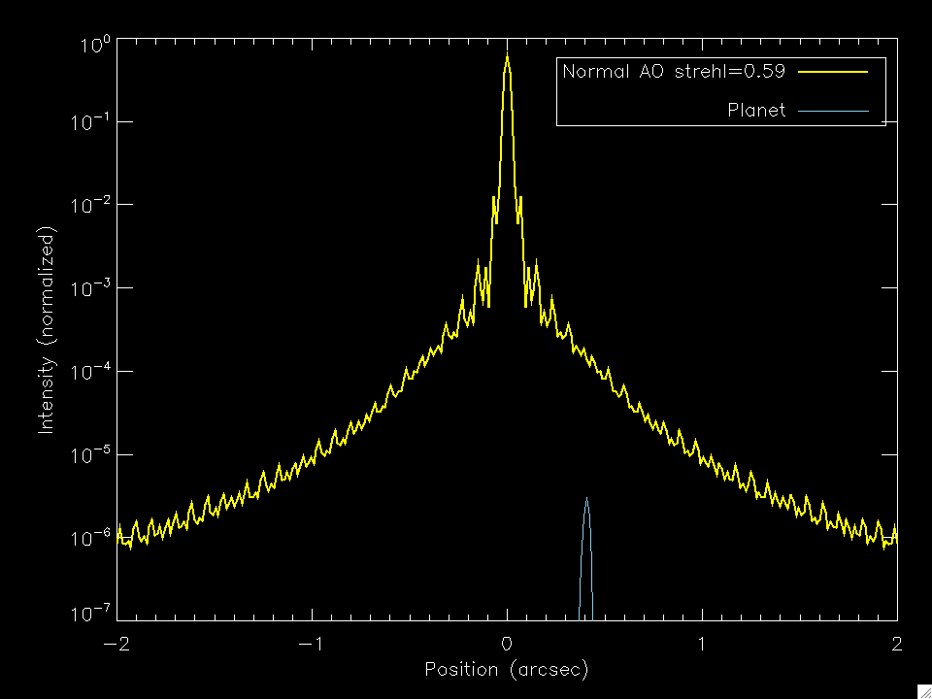
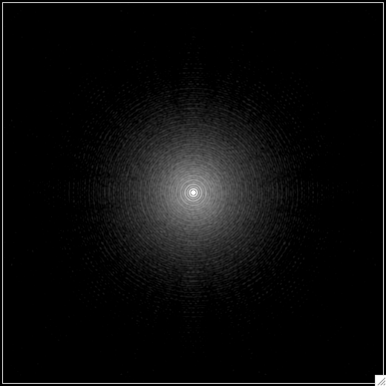
Conventional AO limited by scattered light
Strehl ratio S
Halo intensity 1-S

Slide 10
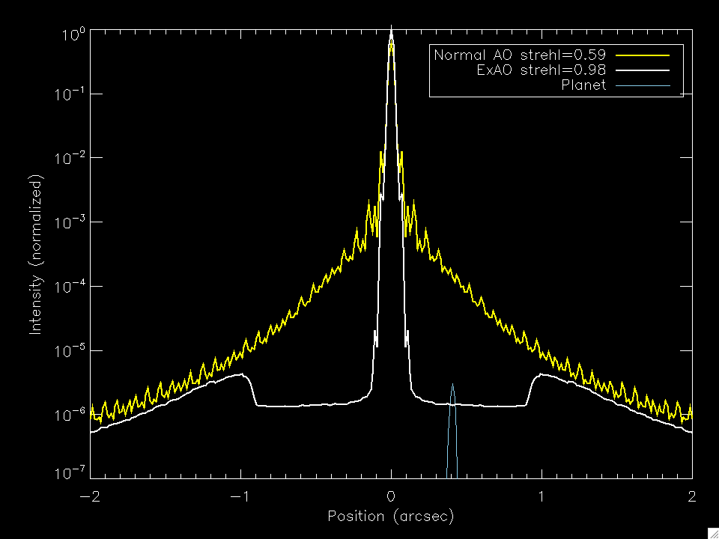
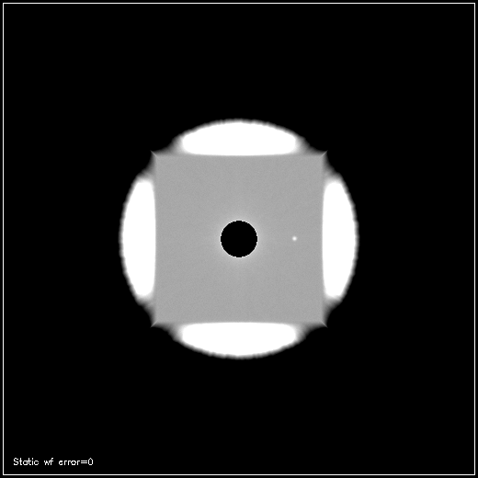
“Extreme” AO (ExAO)
gain > S/(1-S)

Slide 11
But – this assumes no non-common path errors and no AO artifacts

Slide 12
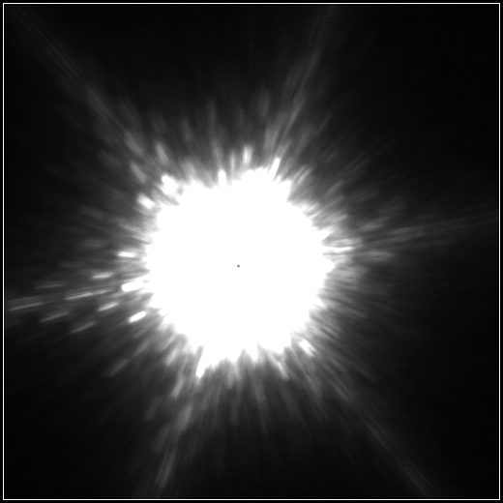
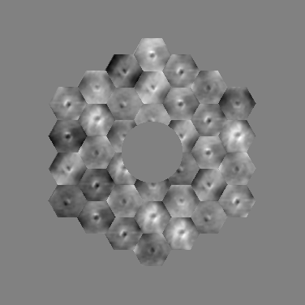
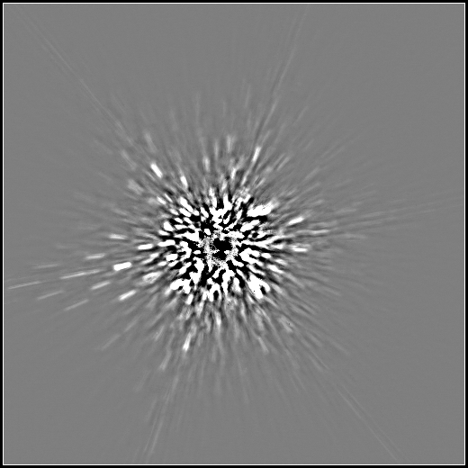
Keck AO Image of a bright star

Slide 13
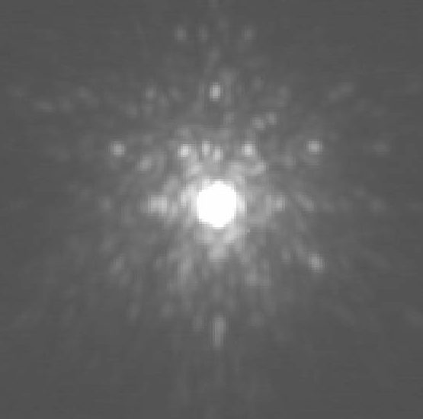
Inner part of image - artifacts due to AO optics

Slide 14
Angular Differential Imaging
Image 1
Image 2 (+ 5 minutes)
Subtraction
Marois et al 2006

Slide 15
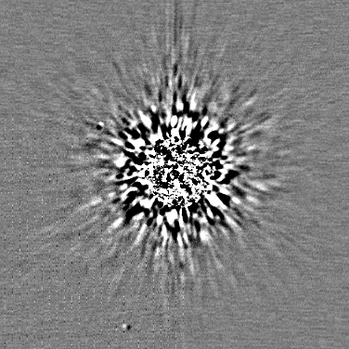
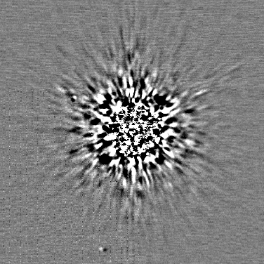
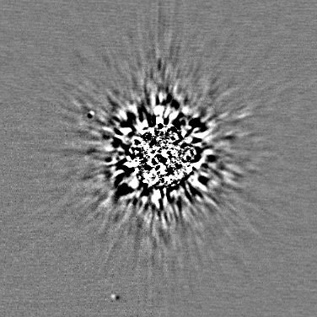
+
=

Slide 16
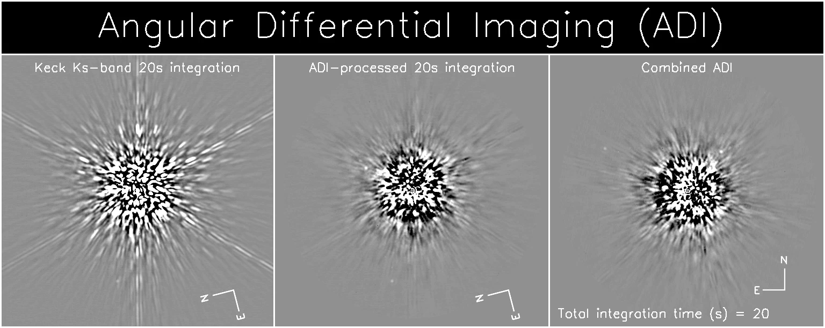
Image processing to suppress light from host star
Marois et al.

Slide 17
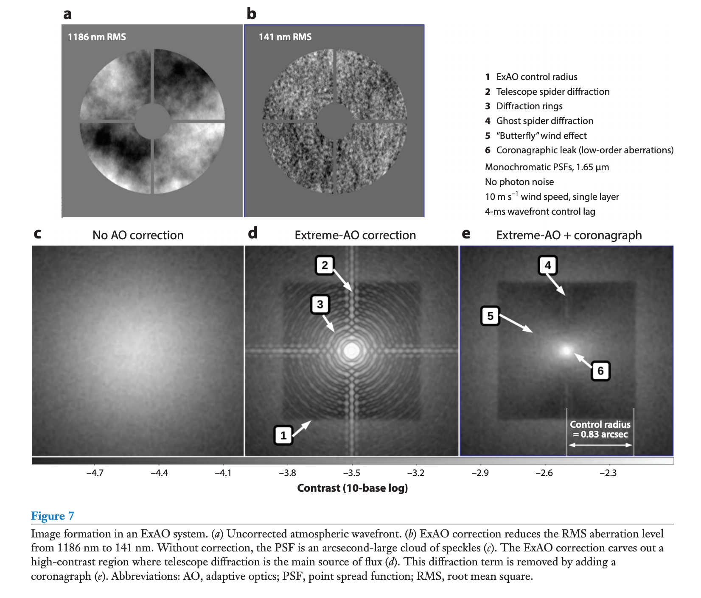
From Olivier Guyon’s Annual Reviews paper

Slide 18
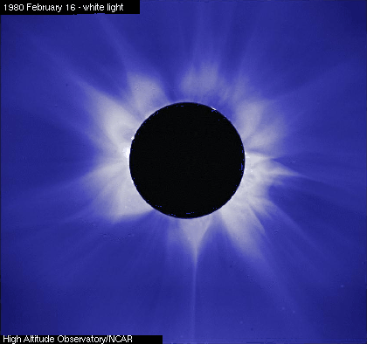
Coronagraphs
Invented by Bernard Lyot in 1930 for studying the corona of the sun without waiting for an eclipse
Block the sun’s light with a circular mask in the focal plane
Problem: diffraction from the sharp edges of the mask

Slide 19
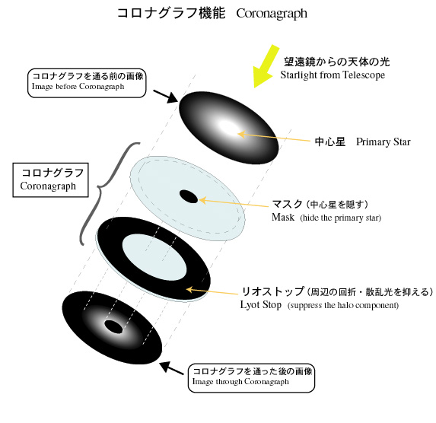
Cartoon of Lyot Coronagraph
Credit: Subaru website

Slide 20
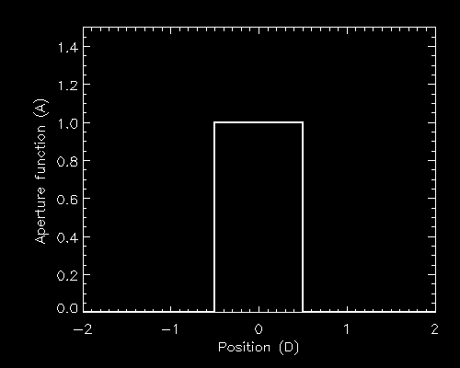
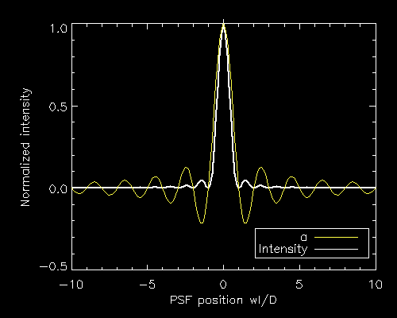
How can we control diffraction?
PSF=|FT(A)|²
A
PSF

Slide 21
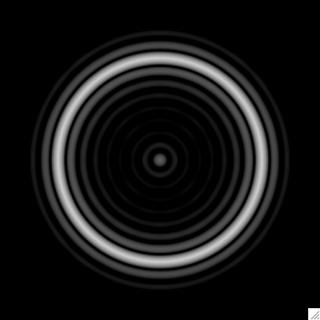
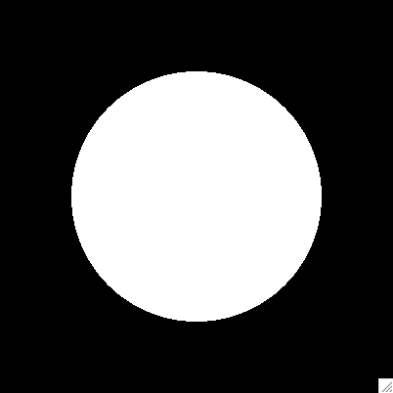
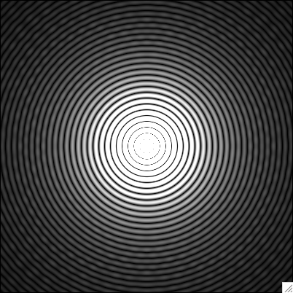
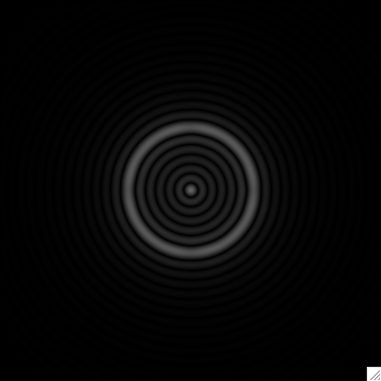
Lyot coronagraph (Lyot, 1933)
Starlight

Slide 22
Lyot coronagraph (Lyot, 1933)
Planet
Sivaramakrishnan et al 2001 has a nice 1-d analysis of how this works

Slide 23
Large variety of coronagraph ideas
Lyot family:
  Basic: Lyot 1939 MNRAS 99, 538; Sivaramakrishnan et al 2001
  Band-limited: Kuchner & Traub 2003
  Apodized: Soummer 2005 Ap.J. 618, L161
Apodizers:
  Shaped-pupil: Kasdin et al 2003, Kasdin et al 2005 Applied Optics 44 1177, etc.
  Phase-induced apodizer: Guyon et al 2005 Ap.J. 622, 744
Interference / wave-optics
  4-quadrant phase mask: Rouan et al 2000 PASP 777 1479
  Nulling interferometer/coronagraphs: Mennesson et al. 2004 Proc. SPIE 4860, 32
Optical Vortex Coronagraphs
Most practical coronagraphs only work at > 3-5 λ/D
Control of phase errors is as important as controlling diffraction

Slide 24
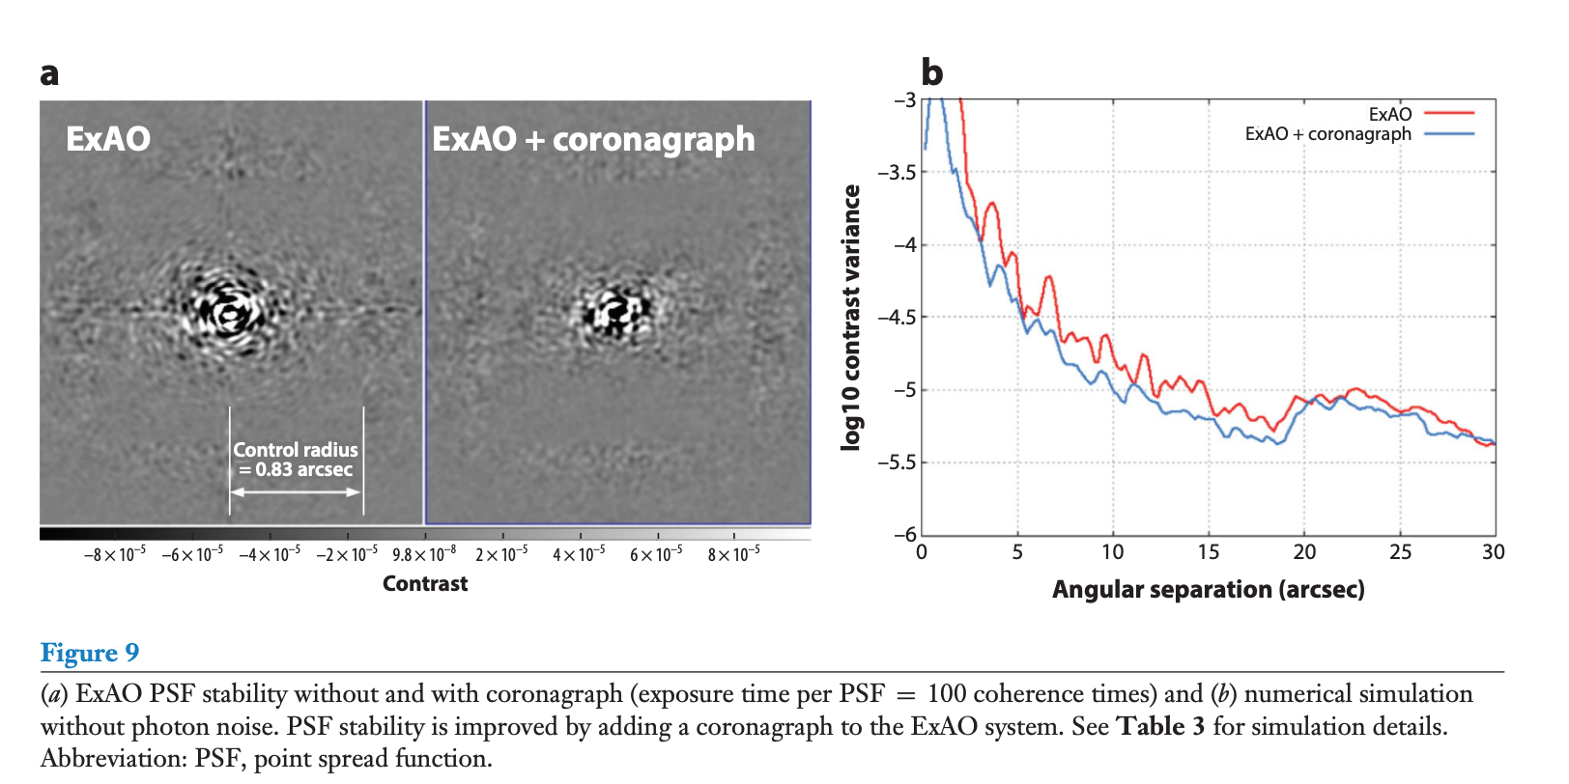
Coronagraph also improves stability
From Olivier Guyon Annual Reviews paper

Slide 25
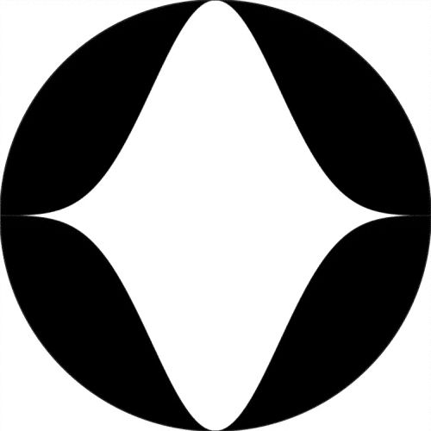
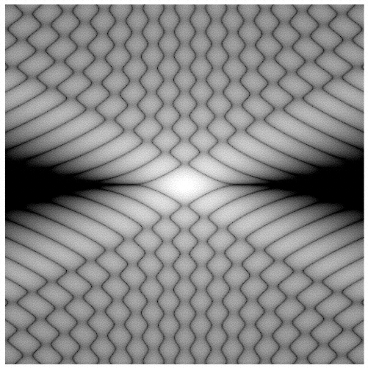
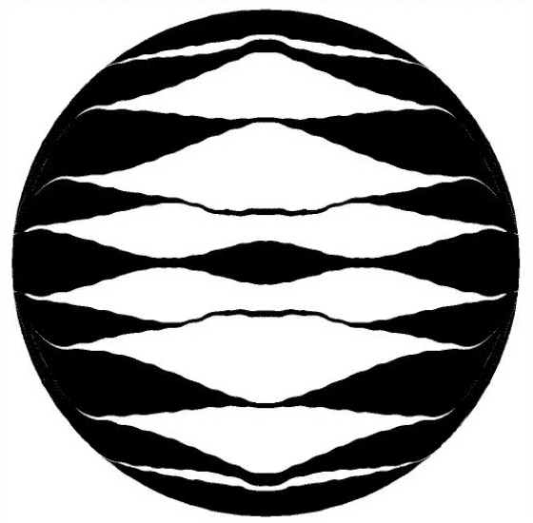
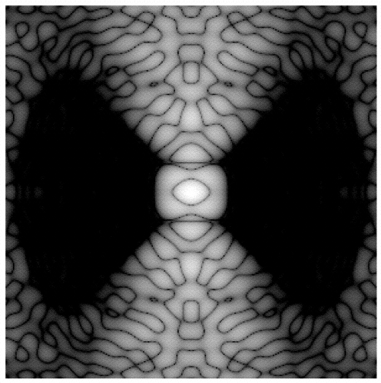
Shaped-pupil coronagraphs to make dark holes (Kasdin et al. 2003)
Pupil
PSF

Slide 26
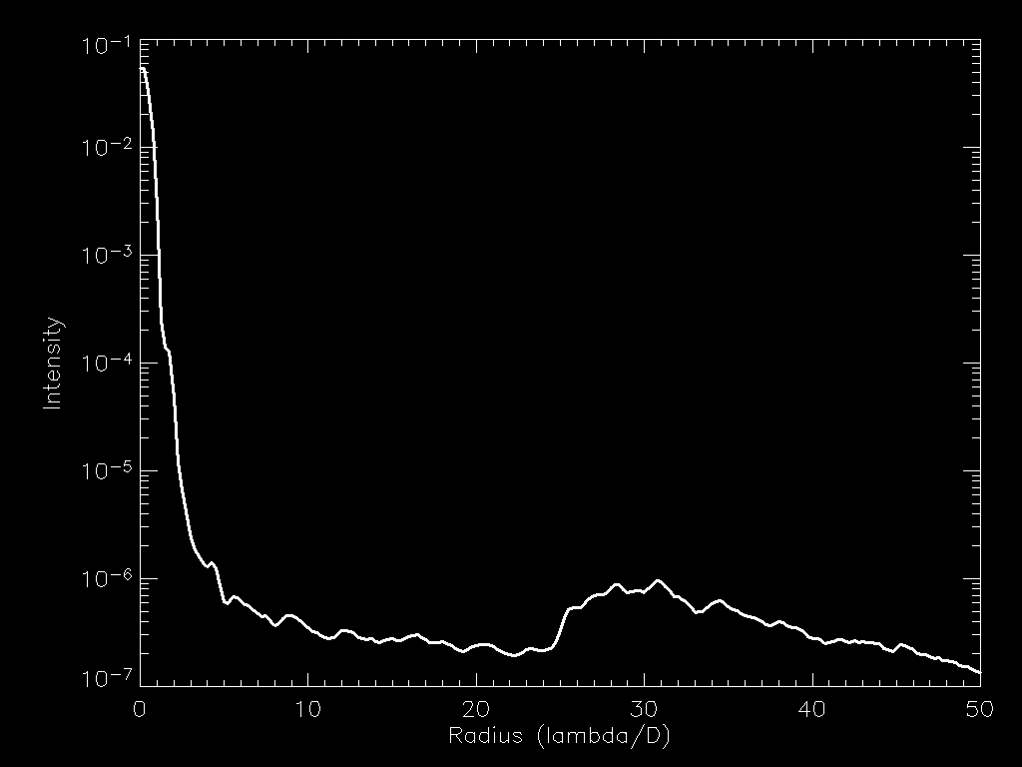
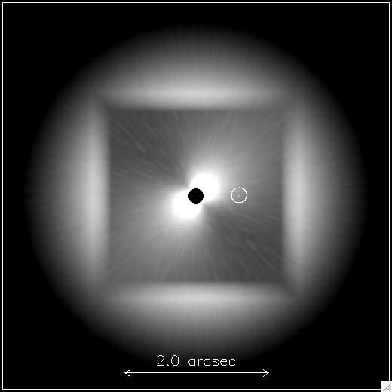
Inner working distance ~ 3-5 λ/D
Outer working distance ~ N λ/D
Fitting error
AO Timelag
WFS measurement

Slide 27
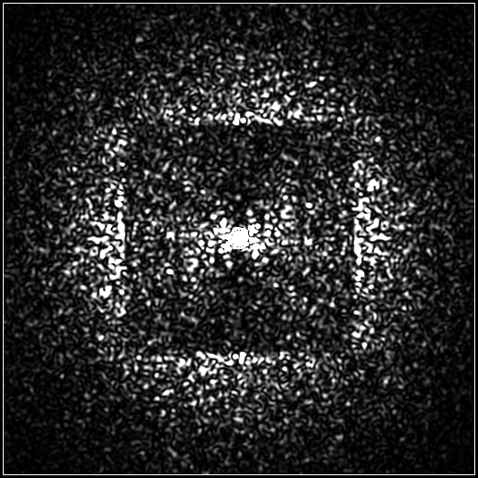
Random intensity of all the Fourier components produces speckles

Slide 28
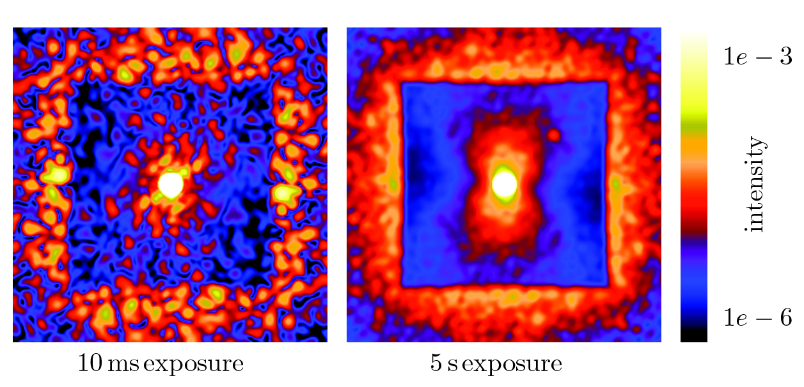
As speckles average out (τ ~ D/v_{wind}) planets can be detected

Slide 29
Must get rid of static errors as well

Slide 30
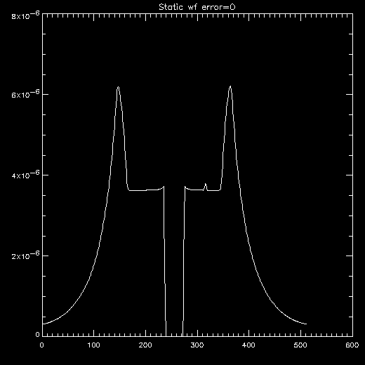
ExAO 0 nm static errors, 5 MJ/500 MYr planet, 15 minute integration

Slide 31

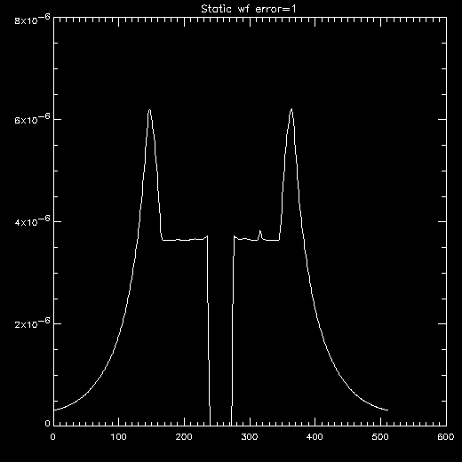
ExAO 1 nm static errors, 5 MJ/500 MYr planet, 15 minute integration

Slide 32


ExAO 2 nm static errors, 5 MJ/500 MYr planet, 15 minute integration

Slide 33
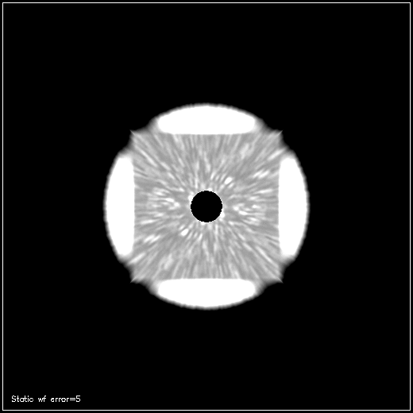

ExAO 5 nm static errors, 5 MJ/500 MYr planet, 15 minute integration

Slide 34
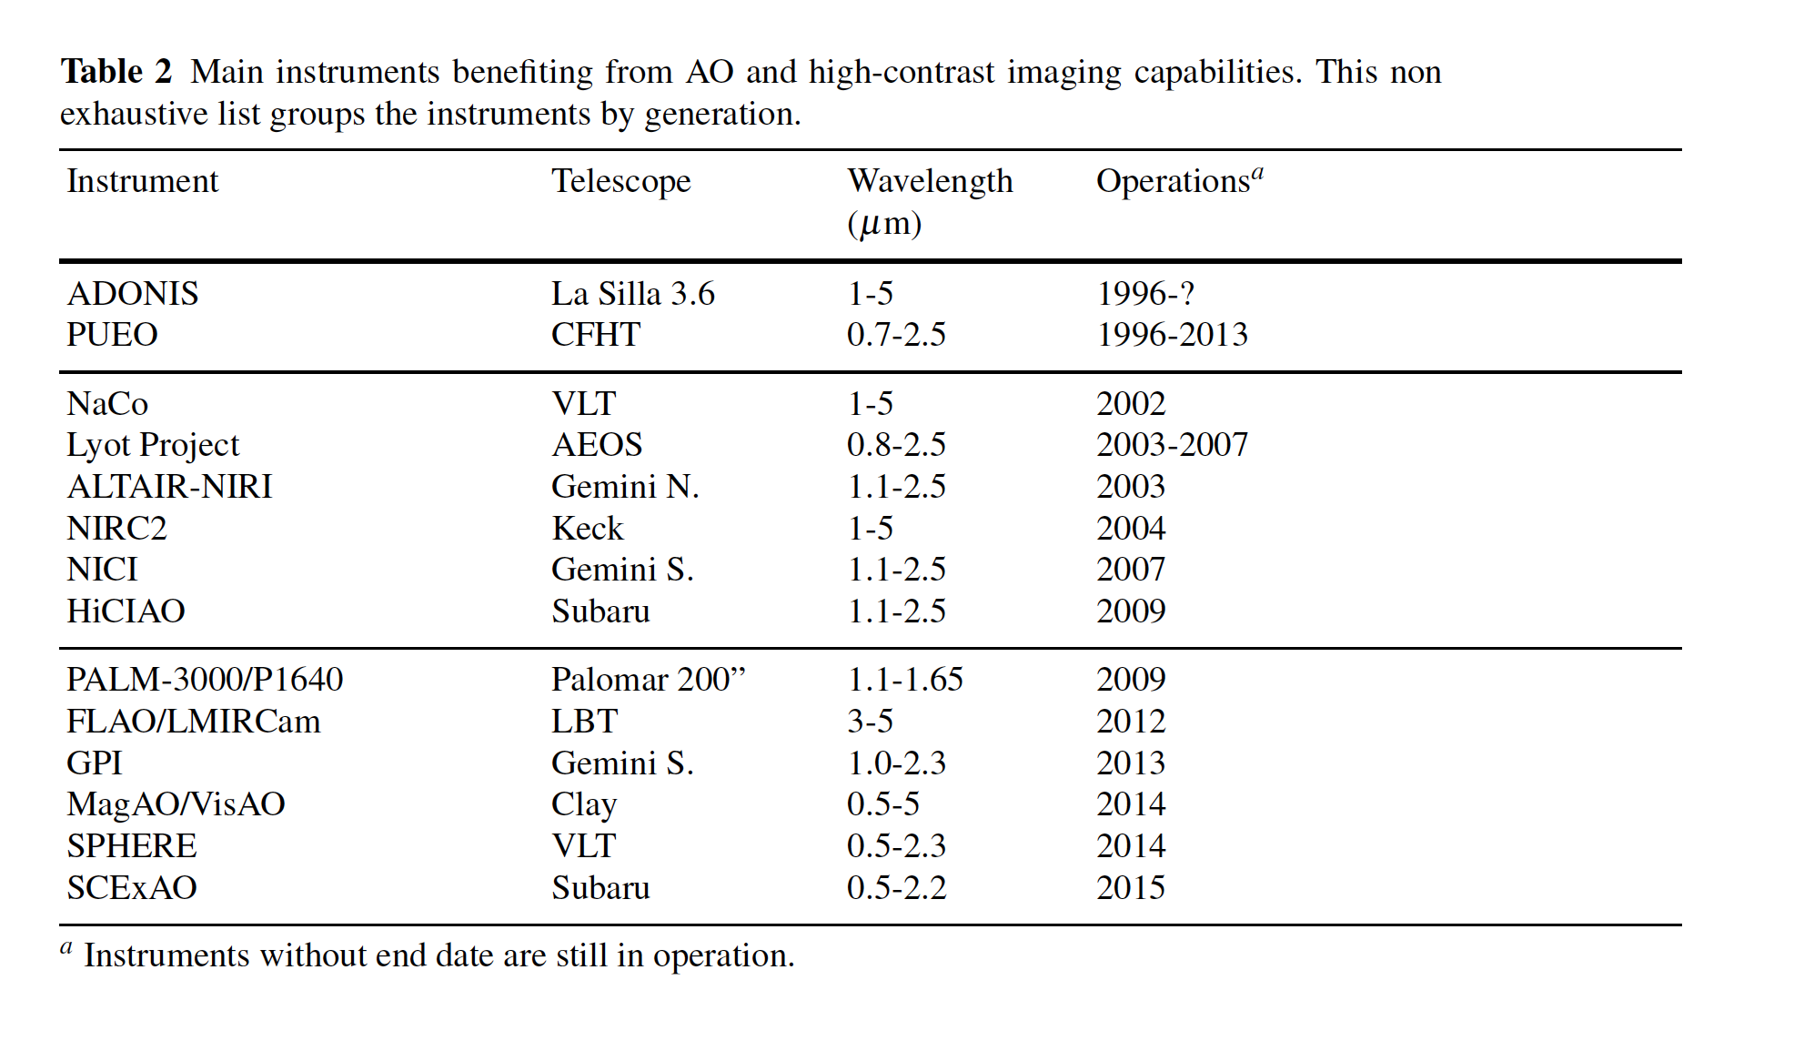
Evolution of AO Systems
Milli et al. 2017

Slide 35
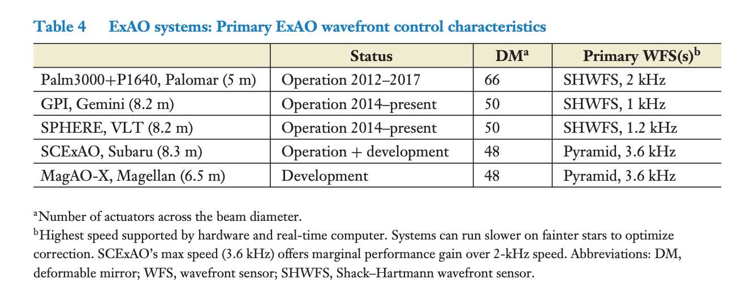
Extreme AO Systems today
From Olivier Guyon Annual Reviews paper

Slide 36
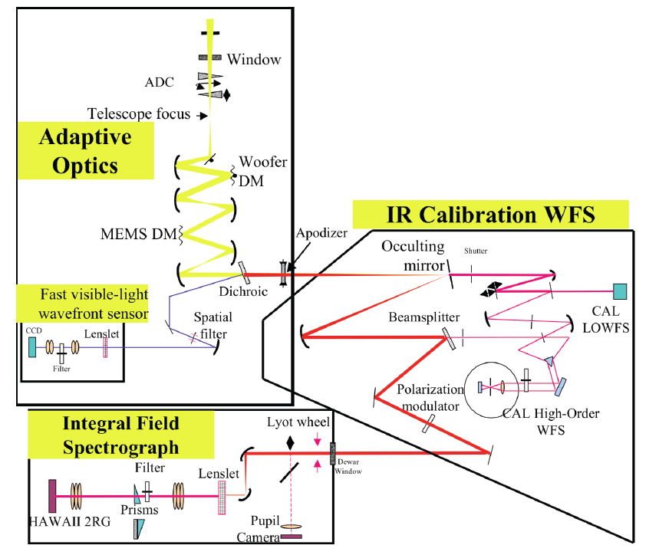
Schematic of Gemini Planet Imager

Slide 37
Comparison of original Keck AO and GPI AO parameters
 | Keck AO (1999) | GPI (2010)
Deformable mirror | 349 actuators (240 active) | 4096 actuators (1809 active)
Subaperture | 56 cm | 18 cm
Control rate | 670 Hz | 2000 Hz
Wavefront sensor | Shack-Hartmann 400 – 1000 nm | Spatially-filtered Shack-Hartmann 700-900 nm
Strehl @ 1.65 μm | 40% | > 90%
Guide star mag (NGS only) | R < 13.5 mag. | I < 9 mag. ( V < 11)

Slide 38
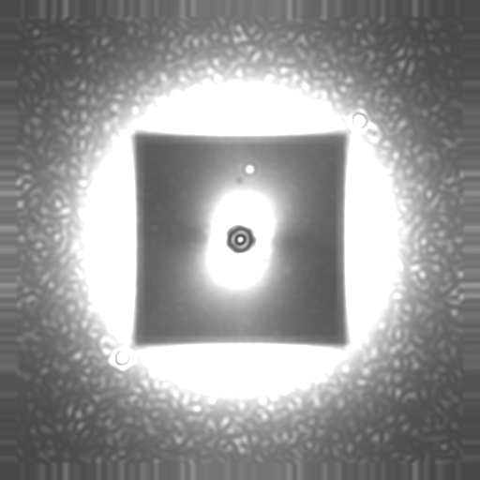
Data pipeline assembles cubes: image of planet as function of wavelength
Christian Marois, HIA

Slide 39
For Class Projects, how to calculate contrast ratio?
Not a simple expression, as it depends on removing internal wavefront errors as well as atmospheric ones, coronagraph performance, etc
One very rough guess (from Milli et al. 2017):
In real systems this is an under-estimate of the contrast
For ExAO, want very high Strehl (>90%)

Slide 40
References, part 1
Angel, R, “Ground based imaging of extrasolar planets using adaptive optics’, 1994 Nature 368, 203 (Original exoplanet paper)
Burrows, A., et al., “A nongray theory of extrasolar planets and brown dwarfs”, 1997 Ap.J 491, 856 (Planet models)
Sivaramakrishnan, A., et al., “Ground-based coronagraphy with High-Order Adaptive optics”, 2001 Ap.J. 552, 397 (Lyot coronagraphs)
Kasdin, N.J., et al, 2003, “Extrasolar planet finding via optimized apodized pupil and shaped pupil coronagraphs”, Ap.J. 582, 1147
Kuchner, M, and Traub, W., “A Coronagraph with a Band-limited Mask for Finding Terrestrial Planets” 2002 Ap.J. 570, 200 (improved Lyot coronagraph)
Sivaramakrishnan, A., et al, “Speckle decorrelation and dynamic range in speckle noise limited imaging”, 2002 Ap.J. 581, L59 (2nd-order PSF expansion)
Perrin, M., et al. “The structure of the High Strehl Ratio Point-Spread Functions”, 2003, Ap.J. 596, 702 (high-order PSF expansion)
Poyneer, L, and Macintosh, B., “Spatially-filtered wavefront sensor for high-order adaptive optics”, 2004, JOSA A 21, 810 (aliasing + WFS)
Guyon, O., et al. “Theoretical Limits on Extrasolar Terrestrial Planet Detection with Coronagraphs”, 2006 Ap.J.S. 167, 81

Slide 41
References, part 2
LaFreniere, D., et al., “A new algorithm for point-spread function subtraction for high-contrast imaging”
Macintosh, B., et al, “The Gemini Planet Imager: From Science to Design to Construction”, 2008 Proc. SPIE 7015-18
Marois, C., et al., 2000, “Efficient Speckle Noise Attenuation in Faint Companion Imaging”, 2000 Proc. SPIE 767, 91
Marois, C., et al., 2006, “Angular Differential Imaging: A Powerful High-Contrast Technique”, 2006 Ap.J. 6541, 556
Marois, C., Macintosh, B., Barman, T., et al, “Direct Imaging of Multiple Planets Orbiting the Star HR8799”, 2008 Science 5906, 1348
Poyneer, L., Macintosh, B., and Veran, J-P., “Fourier transform wavefront control with adaptive prediction of the atmosphere”, 2007 JOSA A 24, 2645

